Slide 1
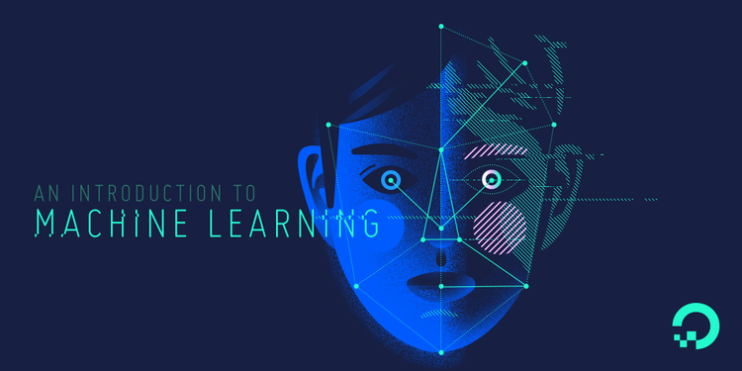
As a part of the assigned work for this course, we are requiring you to complete a project of your own choosing that is based on: Convolutional Neural Networks (CNNs) “Automatic Character Identification System From Video”
CSE-465 Pattern Recognition & Neural Networking

Slide 2
DESCRIPTION
This work aims to realize a recognition system for a software engine that will automatically detect character using
Convolutional Neural Networks (CNNs) from a video content. Our system actually includes tracking a certain character from any content like TV show, cinema, or any other source and to count the character frame time. The main part of our work is to detect and identify faces/character from any series movies. Identification of characters in films, although very intuitive to humans, still poses a significant challenge to computer methods. Now a day’s character Identification from films is a very challenging task due to the huge variation in the appearance of each & every character. It will lead significant research interests and may have many interesting applications in today’s life. It is a challenging problem due to the huge variation in the appearance of each character. In particular, character identification for movie used video and script. Face tracking and clustering from video and name of person extract from script. Many challenges for face clustering and face-name matching are present. In good situation and clean environment existing methods gives better result, but in a complex movie scene performance is limited because face tracking and clustering process generate a noise. This task is challenging since characters present significant variation in their appearance.

Slide 3
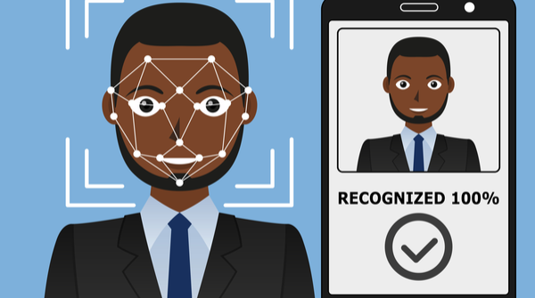
The face recognition system generally involves two stages:
Face Detection – where the input image is searched to find any face, then image processing cleans up the facial image for easier recognition.
Face Recognition – where the detected and processed face is compared to the database of known faces to decide who that person is.

Slide 4
THINGS THAT WE HAVE USED
For the face recognition in both images and video we have used:
OpenCV
Numpy
Keras
Python
Skimage
Deep learning
To perform face recognition with Python and OpenCV we have used two libraries:
(1) Dlib
(2) Face_recognition
Dataset:
Face recognition dataset was created programmatically with Python and the Bing Image Search API.

Slide 5
UPDATE
Currently we are done with the character recognition from video frame
And we are working on the process where there will be a output of calculate the screen time of that particular character includes.
Let’s assume that we have a different image on each page of the book, and as we flip these pages, we get an animation of a particular scene. You could even call it a kind of video. The visualization gets better the faster we flip the pages. In other words, this visual is a collection of different images arranged in a particular order.
Similarly, videos are nothing but a collection of a set of images. These images are called frames and can be combined to get the original video. So, a problem related to video data is not that different from an image classification or an object detection problem. There is just one extra step of extracting frames from the video.
Actually, our challenge here is to calculate the screen time of any particular character from a given video.
So I have done it in a way:
Import and read the video, extract frames from it, and save them as images
Label a few images for training the model
Build our model on training data
Make predictions for the remaining images
Calculate the screen time of any particular character

Slide 6
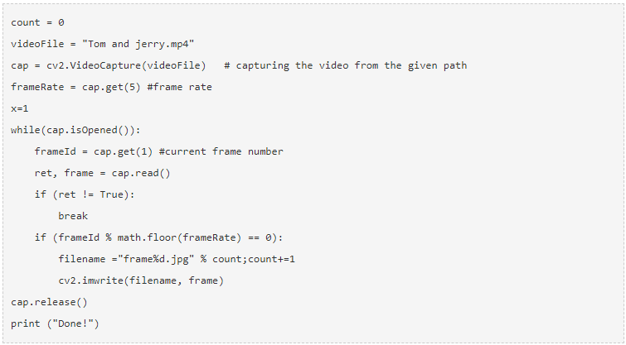
PIECE OF CODE

Slide 7
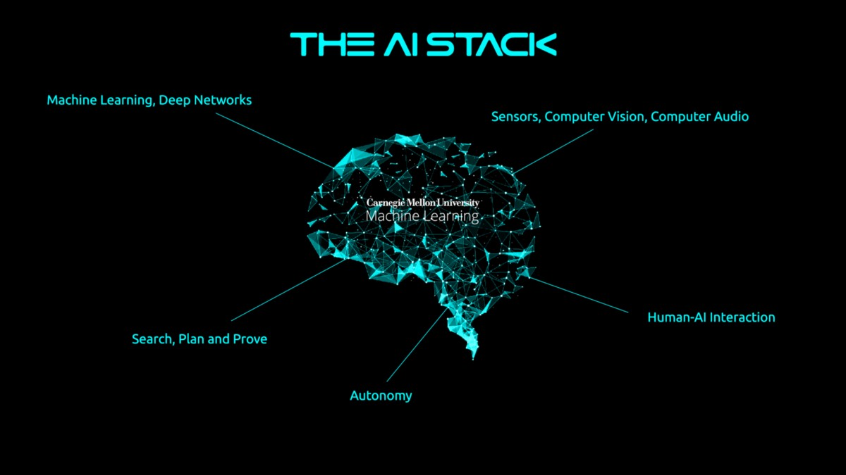
Thank You!!

